Slide 1
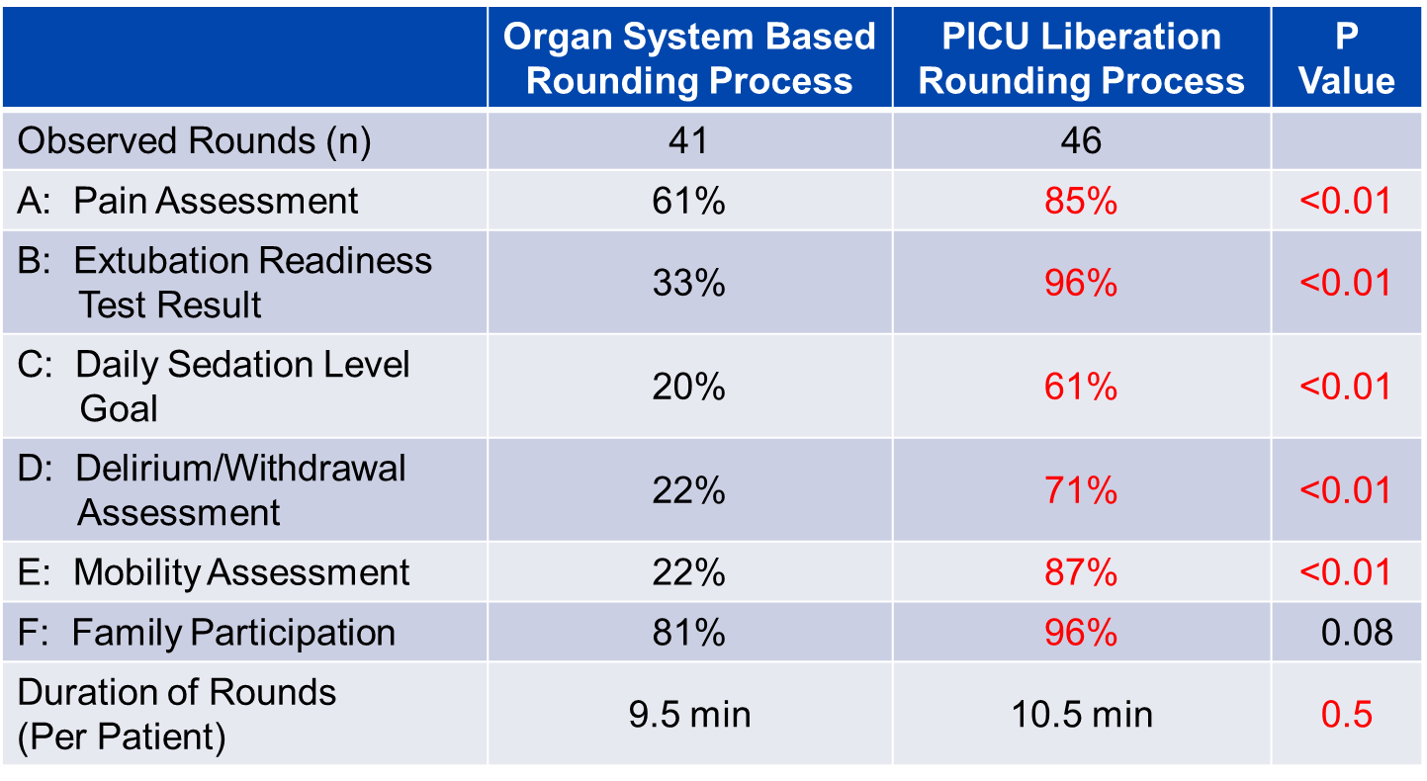
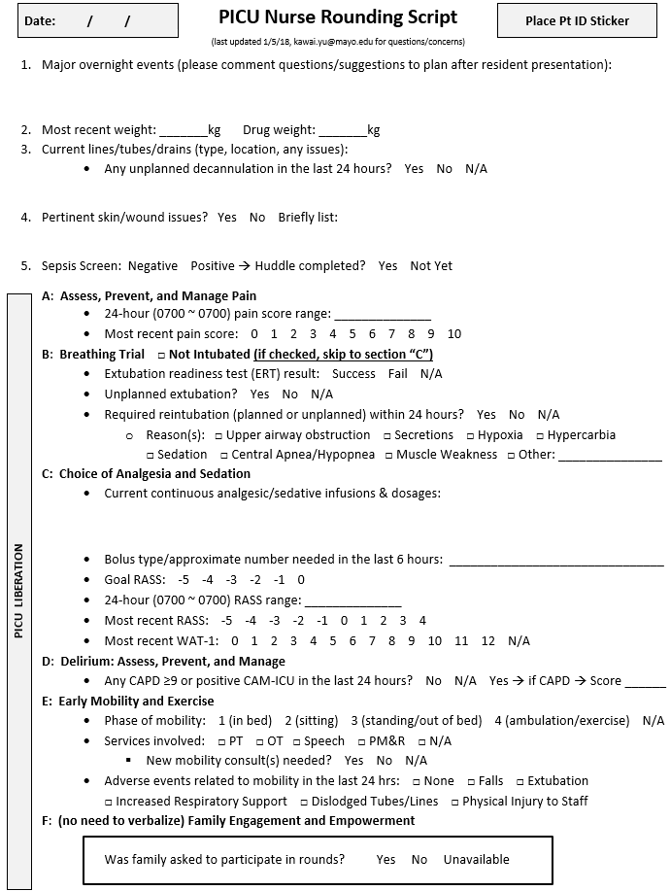
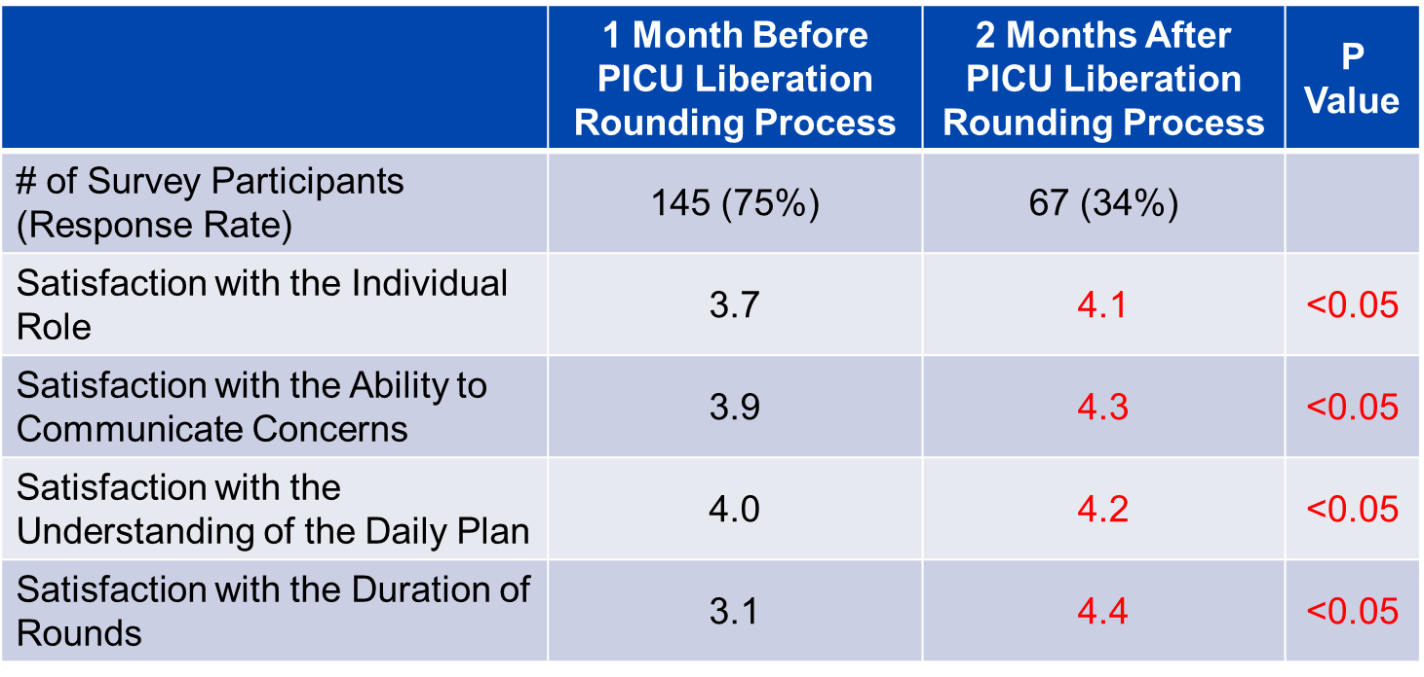
De-Escalation of Critical Care and Prevention of Iatrogenicity Through PICU Liberation Rounding Process and a Daily Rounding Checklist
Yu Kawai MD¹; Michael Nemergut MD PhD²; Yves Ouellette MD PhD¹; Brenda Schiltz MD¹; Gina Rohlik APRN³; Lori Neu DNP³; Scott Feigal MSN³; Debra Rowekamp MS RN³; Britt Fetterly BSN³; Karen Fryer BSN⁴; Robert Kahoud MD¹; Grace M Arteaga MD¹
¹Division of Pediatric Critical Care, ²Department of Anesthesia and Pediatrics, ³Department of Nursing, ⁴Division of Anesthesia Clinical Research
Mayo Clinic Children’s Center, Rochester MN
Background
Methods - Implementation
Frequency of Bundle Discussion
PICU Liberation ABCDEF Bundle was recently implemented to:
Standardize weaning of ICU support after clinical stabilization
Prevention of iatrogenicity
A: Assess, Prevent, and Manage Pain
B: Breathing Trials
C: Choice of Analgesia and Sedation
D: Delirium Assessment, Prevention, & Management
E: Early Mobility and Exercise
F: Family Engagement and Empowerment
PICU Liberation nursing rounding script developed and implemented (Figure 1)
Focused on PICU Liberation elements
Previous script organized by organ system
14-task, physician-completed de-escalation checklist developed and implemented (Figure 1)
All checklists completed over the first 50 days after deployment collected
Figure 1. New Rounding System
Data from the Rounding Checklist
Compliance rate for first 50 days:
90.4% (322/356 total patient-days)
Frequency of medical plan modification:
62 times in 14.0% (45/322) of the total checklists completed
Most frequently modified tasks (>75% of all):
Converting IV to PO meds
Initiating bowel regimen
Initiating GI prophylaxis
Consulting PT/OT/PMR
Initiating sleep enhancement protocol
Objectives
To implement a new bedside nurse rounding script and a physician-led de-escalation daily rounding checklist to:
Improve PICU Liberation ABCDEF Bundle compliance
Reduce the risk for iatrogenic conditions
Methods – Data Collection
5 point Likert Scale survey related to ICU Liberation Bundle distributed to MDs, nurses, respiratory therapists, pharmacists, and dieticians
1 month prior and 2 months after the implementation of the new rounding system
Assessed for satisfaction with rounds
Independent observers collected data during rounds
Assessed for frequency of PICU Liberation ABCDEF Bundle element discussion
Satisfaction with the Rounding Process
Conclusions
PICU Liberation nursing script:
Improved care provider satisfaction with rounds
Increased adherence with the ABCDEF Bundle
Physician-completed daily rounding checklist:
Achieved high compliance
Increased timely de-escalation of care
Minimized the risk of iatrogenic conditions

