Slide 1
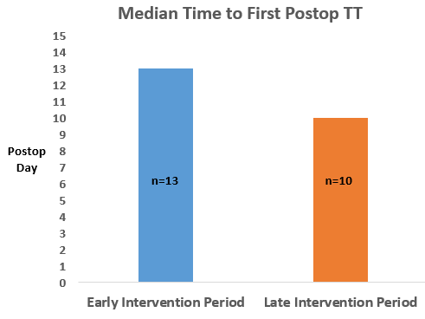
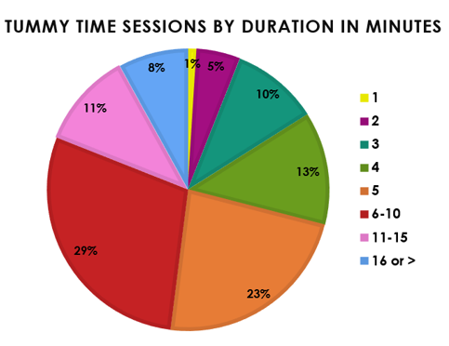
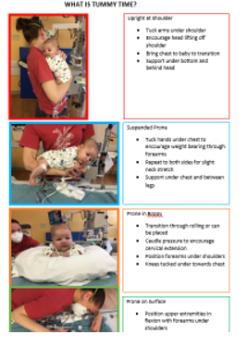
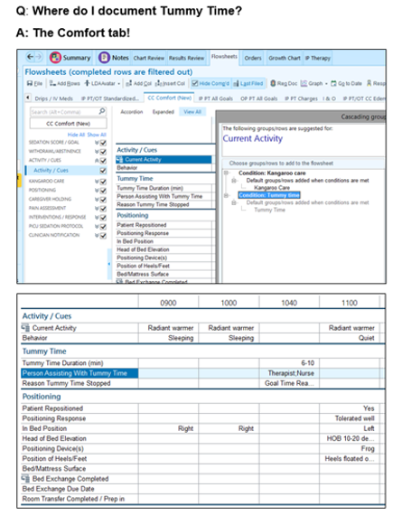
Quality Improvement Initiatives Promote Tummy Time Therapy for Infants
in the Cardiac Intensive Care Unit
Nancy Rudd MS APNP, Ann Scott MSN APNP, Sonya Baillie OTD, OTR/L, Holly Hyland DPT, Kristin Kroll PHD,
Sravya Bagli MBA MHA, Michele Frommelt MD, Stephanie S. Handler MD
Pediatrics, Medical College of Wisconsin, Milwaukee, WI, Section of Pediatric Cardiology
The Herma Heart Institute, Children’s Wisconsin, Milwaukee, WI
BACKGROUND
METHODS
RESULTS
Tummy Time (TT) is a form of supervised prone positioning when an infant is awake and alert.
TT promotes gross motor development and has been shown to be a safe intervention for hospitalized infants.
Initiation of TT after sternotomy at Children’s Wisconsin is determined by medical stability and status of surgical lines/ tubes, not time.
A multi-disciplinary team focused on improving gross motor outcomes for infants in our CICU was established.
Quality improvement began in July 2020 and year-long initiatives included:
Educating staff and parents on the benefits of TT
Increasing frequency of TT sessions
Shortening time from cardiac surgery to initial TT therapy
Adapting the EMR to facilitate TT documentation
Promoting TT practice through an incentive-based “Piece of the Pie” contest
AIMS
Infants in our Cardiac Intensive Care Unit (CICU) often participated in TT only during physical or occupational therapy session and efficient documentation was lacking.
Aims of this project were to educate caregivers on the importance of TT, initiate TT as early as safely possible after surgery, increase nursing initiation and improve electronic medical record (EMR documentation).
RESULTS
Early group (7/20-12/20, n = 78 patients / 421 TT sessions) was compared to Late group (1/21-6/21, n = 72 patients / 341 TT sessions). 16 patients were in both groups.
Median time to first postoperative TT session decreased from 13 to 10 days. Number of patients with >1 TT session increased from 61.5% to 66.7%.
The most frequent duration of TT was 6-10 minutes (29%) and 71% of TT sessions had a documented duration ≥ 5 minutes.
Fifteen nurses initiated TT in June 2021 for the TT incentive contest compared to 10 nurses the previous month.
No adverse events were reported for infants placed in TT
One infant developed an uncomplicated, superficial sternal wound infection.
CONCLUSION
Targeted initiatives demonstrate TT can be safely incorporated into the developmental care of CICU infants and shorten time to initial postoperative TT.
Education and motivational initiatives can jumpstart the implementation of and increase provider participation in essential developmental therapies for hospitalized cardiac infants.
There are no financial relationships to disclose or conflicts of interest to resolve.

